Slide 1


Final Project Defense
On “MACFUTSAL”
A
Submitted by:
Binay Adhikari [21828/075] Mabisha Koirala [21833/075] Ramesh B.K[21838/075]
Submitted to:
Institute of Science and Technology Tribhuvan University

Slide 2
Our Content
Introduction
Objective
Literature Review
Scope and Methodology
Requirement Analysis
Feasibility Study
Use Case Diagrams
System Design
Flowchart
Testing
Implementation
Future Enhancements
Outcomes

Slide 3
"MACFUTSAL"
Digitizing the futsal program

Slide 4
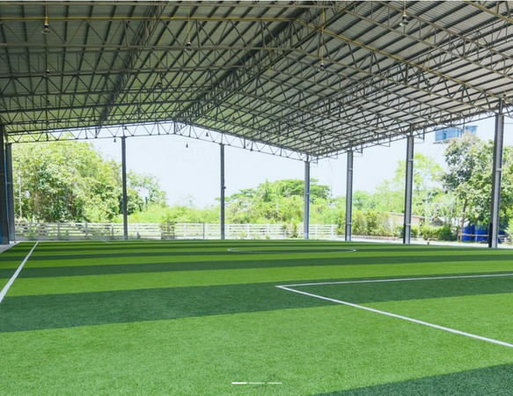
What is MACFUTSAL?
A digital platform to manage the Futsal Program for Mount Annapurna Campus . Simply , a way to register players team selection and manage gameplay.
Use of smartphones, laptops for user registration.
Passwords are stored in encrypted form. User Authentication with e-mail validation.
Easier to manage and create schedules, Posts and updates, User and roles management.

Slide 5
Objectives
To automate the process of managing futsal tournaments and scheduling games, this will reduce errors and increase efficiency.
To make a triparty(college, students ,futsal) communication for effective extra curriculum management especially futsal.

Slide 6
Literature review
Several studies have been conducted to explore the feasibility and effectiveness of futsal management systems.
Study by Al-Radaideh et al. (2018) developed a futsal management system that allowed the registration of teams, the creation of fixtures, the management of scores, and the generation of reports. The system was implemented in a Jordanian university.
In a study conducted by Ahmad et al. (2019), a futsal management system was developed and implemented in a Malaysian university. The system was found to significantly improve the efficiency and effectiveness of futsal management.
Similarly, a study by Akyol et al. (2020) developed a futsal management system for a Turkish university and found that it improved the management of futsal tournaments and reduced the workload of administrators.
Another study by Raju et al. (2021) developed a futsal management system for a college in India, which included features such as player registration, team management, fixture creation, score management, and league tables.

Slide 7
Methodology
Scope
Requirement Analysis
Design and Development of Software
SRS document
Agile Method
Adaptive to evolving requirements. Time-critical Projects.
Small development teams with
close
collaboration and communication.
User-centered design, where the software is developed based on user feedback and input.
Innovative or experimental development

Slide 8
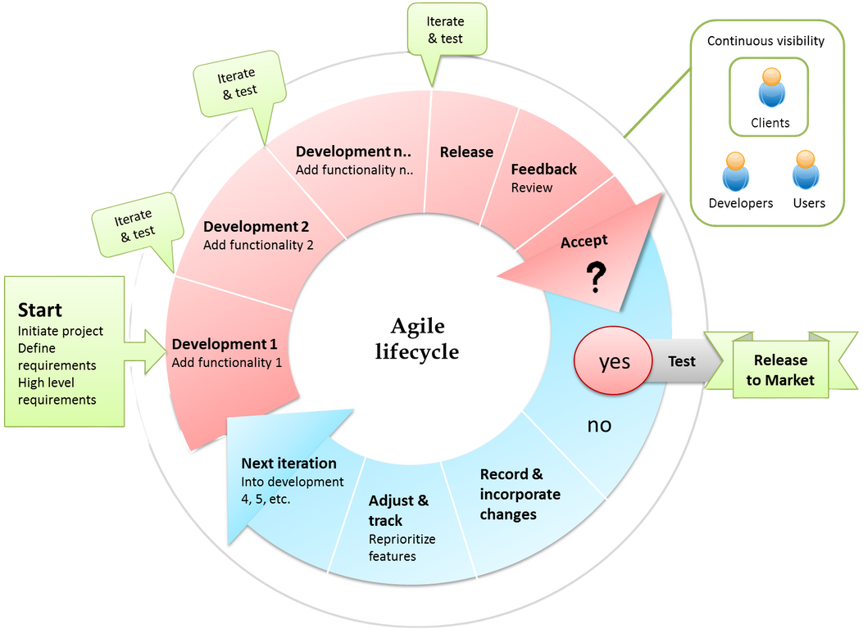
Fig : Agile Methodology

Slide 9
Requirement Analysis
Functional Requirement
schedule and manage the use of futsal facilities.
generate reports on team and player performance.
secure and protect user data and confidential information.
Assign permissions and roles to players.
Non-Functional Requirement
Performance Accuracy Maintainability Reliability
Security
Portability and Compatibility

Slide 10

Feasibility study
Technical Feasibility
Operational Feasibility
Economic Feasibility
Legal Feasibility

Slide 11
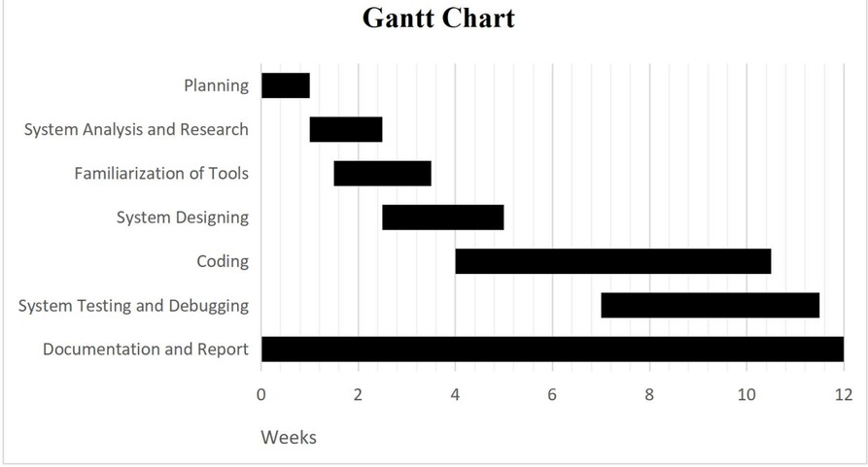
Gantt chart
figure: Gantt chart

Slide 12
USE CASE DIAGRAM
&
USE CASE DESCRIPTIONS

Slide 13
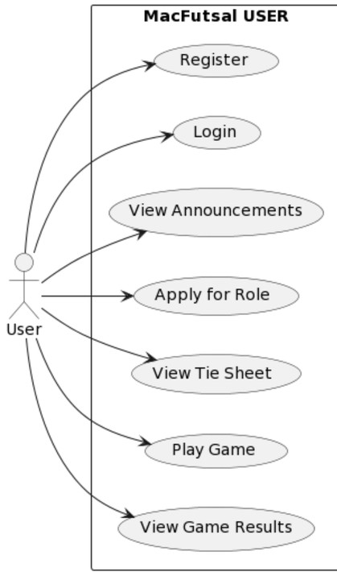
Figure 7. Use-case Diagram of User

Slide 14
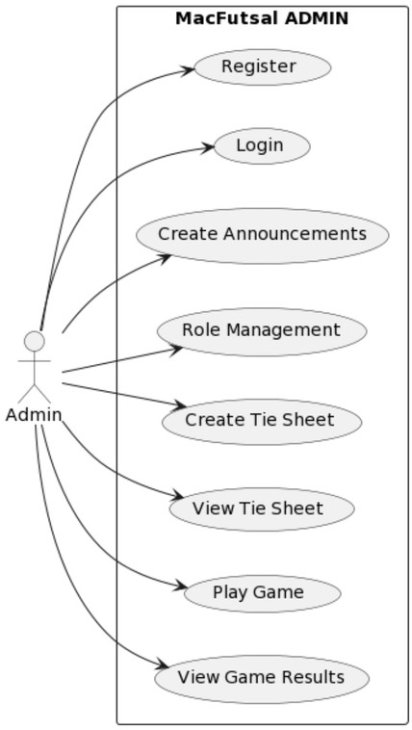
Figure 7. Use-case Diagram of Admin

Slide 15
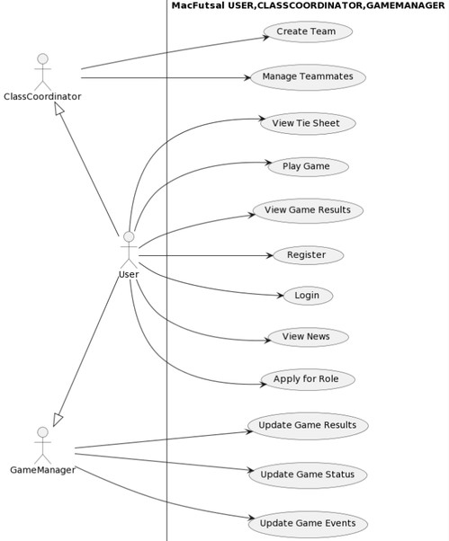
Figure 7. Use-case Diagram of Class Coordinator and game manager

Slide 16
USER REGISTRATION
User Case Name
Actors Description Goal
Basic Course of Action
Course of Action
Exit Condition
User Register
user
This activity performs when the user wants to register To register user detail
Actor action System response.
1. Users click on ‘Register’.
2. The System displays a registration page.
3. User fills in their personal details.
4. System validates the page.
5. User click on ‘register’ button.
6. The System records the active users of the system’s Database.
7. Use case ends.
If the form is invalid, the system returns to the basic course of action and indicates to the user where he/she made an error.
Logout

Slide 17
USER LOGIN
User Case Name
User Register
Actors
user
Description
It is an authenticating bridge that allows users to login to the system.
Goal
To be accessed by an authorized and trust system user.
Precondition
Users should be registered.
Course of Action
If the username or password is invalid, the system returns to the basic course of action and indicates to the user where he/she made an error.
Post Condition
System transfer access to the pages which are not accessible without login.
Exit Condition
Logout

Slide 18
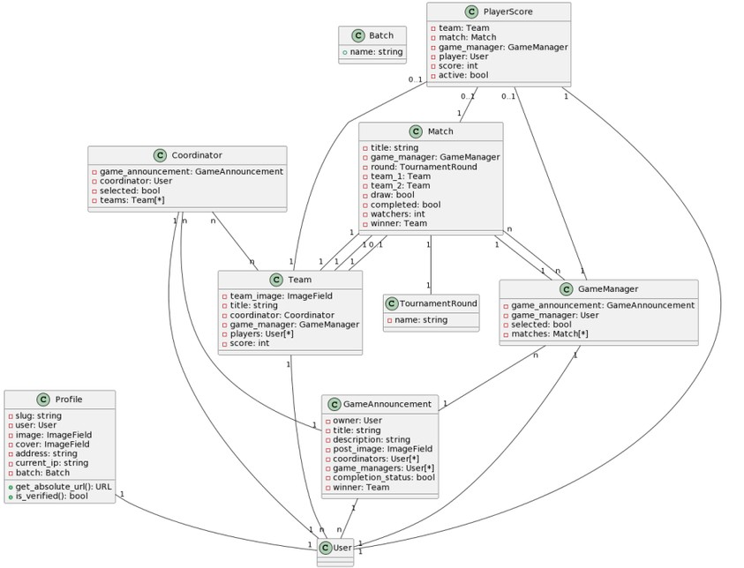
Class and object diagram
Figure: Class and Object Diagram

Slide 19
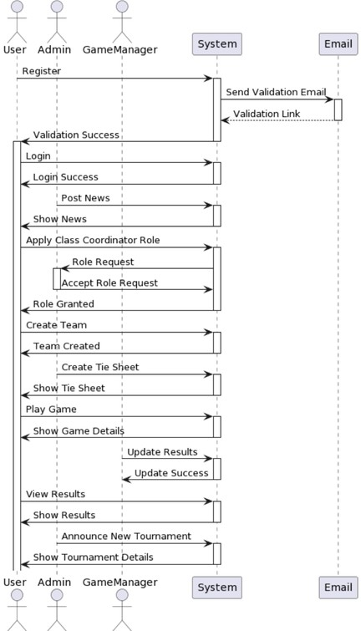
Sequence Diagram
Figure: Sequence Diagram

Slide 20
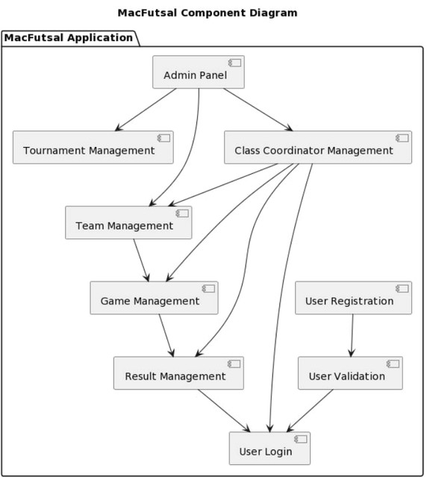
Component Diagram
Figure: Component Diagram

Slide 21
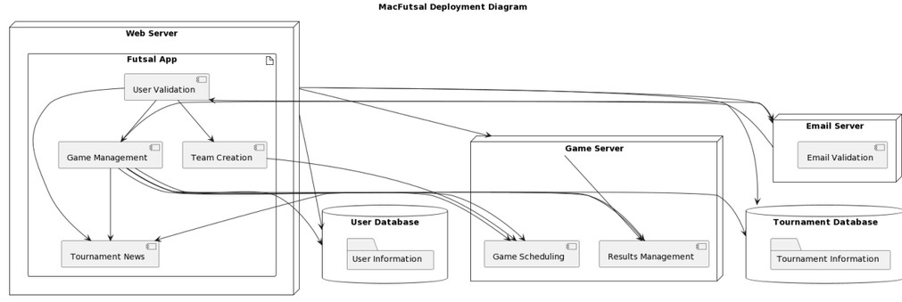
Deployment Diagram
Figure: Deployment Diagram

Slide 22
System Design

Slide 23
Database Design
Database design allows us for the creation of a structured and organized database that can efficiently store, manage, and retrieve data.
Database design can optimize database performance by reducing
data redundancy,minimizing data retrieval time, efficient queries.
The following are the database models in MacFutsal.
and enabling

Slide 24
Admin
Table 1:Database Table for Admin
S.N.
1
2
3
4
Field
Id(Auto increment)
name
email
password
Data type
integer
varchar
varchar
varchar
Length
10
50
50
50
Description
Id of the admin registration
Username of the admin
Email of the admin
Password For the security

Slide 25
User
Table 2. Database table for user
S.N.
1
2
3
4
5
6
7
8
9
10
Field
Id(Auto increment)
User Name email
First name Last name
password
Date joined Is_staff
Is_ClassCoordinator
Is_Game Manager
Data type
integer
Varchar(Not NULL UNIQUE)
Varchar(Not NULL) Varchar (NOT NULL) Varchar (NOT NULL)
Varchar(NOT NULL)
datetime (NOT NULL) Bool (NOT NULL)
Bool (NOT NULL)
Bool (NOT NULL)
Length
10
150
254
150
150
128
1
1
1
Description
User id assigned during registration
Username of user
Email of user First name of user Last name of user
Password for security
Date of user joined Staff status
Is user given role of Class Coordinator
Is user assigned role of Game Manager.

Slide 26
Futsal Announcement
Table 3. Database table for Game Announcement
S.N.
1
2
3
4
5
Field
Id Title
Created at Updated at Coordinator_id
Length
10
240
10

Slide 27
Futsal Game
Table 4. Database table for Futsal Game
S.N.
1
2
3
4
5
Field
Id Title
Created at
Updated at GameManger_id
Data type
Integer (NOT NULL) varchar(NOT NULL)
Datetime(NOT NULL)
Datetime(NOT NULL) integer(NOT NULL)
Length
10
240
10

Slide 28
Player score
Table 5. Database table for Player score
S.N.
1
2
3
4
5
Field
Id Score
Game id
Player id Team id
Data type
Integer (NOT NULL) varchar(NOT NULL) Datetime(NOT NULL)
Datetime(NOT NULL) Bigint(NOT NULL)
Length
10
240
10

Slide 29
Teams
Table 6. Database table for Teams
S.N.
1
2
3
4
5
6
Field
Id
Team name Score Created at Updated at
coordinator_id
Data type
Integer (NOT NULL) varchar(NOT NULL) Real(NOT NULL)
Datetime(NOT NULL) Datetime(NOT NULL) integer(NOT NULL)
Length
10
240
10
10

Slide 30
Teams
Table 6. Database table for Teams
S.N.
1
2
3
4
5
6
Field
Id
Team name Score Created at Updated at
coordinator_id
Data type
Integer (NOT NULL)
varchar(NOT NULL) Real(NOT NULL)
Datetime(NOT NULL) Datetime(NOT NULL)
integer(NOT NULL)
Length
10
240
10
10

Slide 31
Team Members
Table 7. Database table for Team Members
S.N.
1
2
3
Field
Id
Team id
User id
Data type
Integer(NOT NULL)
Bigint(NOT NULL)
integer(NOT NULL)
Length
10
10
10

Slide 32
Flowchart

Slide 33
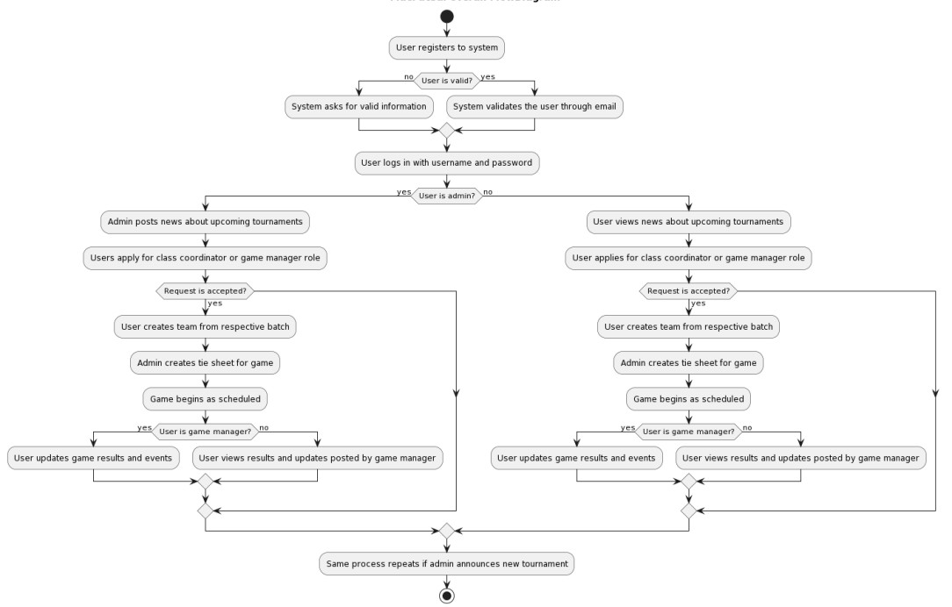
Overall Flow Diagram
Figure: Flow Diagram

Slide 34
TESTING

Slide 35
Testing Approaches
Software testing is a set of process aimed at investigating, evaluating and ascertaining the completeness and quality of computer software.
The objectives of these processes can include
Verifying software completeness in regards to functional/business requirements.
Identifying technical bugs/errors and ensuring the software is error-
free.
Assessing usability, performance, security, compatibility and installation.

Slide 36
Testing Approaches
Unit Testing
Stress Testing
Actual system Testing
Functional Testing
System Testing
White Box Testing
Black Box Testing

Slide 37
Implementation

Slide 38
Tools Used
Frontend
HTML CSS JS
BOOTSTRAP
Backend
Python
Django (Framework) SQLite

Slide 39
Future Enhancements
There are limitations in our web application. To overcome those limitations, we plan to add the following features to our applications:
Mobile App
Real-time Analytics
AI-Powered Scheduling

Slide 40
Outcome
Only admin can assign roles and permission to the desired applicants and discard after the work completion.
After verifing user e-mail, a token will be generated ,and can login the system.
Instant display of admins post and updates is featured.

Slide 41
Thank You!

